Slide 1
Secure data hiding in images using steganography
CAPSTONE PROJECT
Presented By:
Student Name : Penmetsa Hari Akshaya Varma
College Name & Department : Gayatri Vidya Parishad College for Women – [ECE]

Slide 2
OUTLINE
Problem Statement
Technology used
Wow factor
End users
Result
Conclusion
Git-hub Link
Future scope

Slide 3
Problem Statement
In today's digital age, the risk of confidential data leakage is a significant concern. To address this issue, the project aims to develop an effective steganographic system capable of concealing sensitive information within digital images.
By embedding data covertly into images, the system ensures that the hidden information remains undetectable to unauthorized users, thereby enhancing data confidentiality and mitigating the risks associated with data leakage.

Slide 4
Technology used
Programming Language: Python
Libraries: OpenCV, OS, String
Tools: Jupyter Notebook / VS Code/python IDLE

Slide 5
Wow factors
What makes this project stand out from other project(Unique Features)
Uses Least Significant Bit (LSB) Steganography, one of the most efficient and undetectable methods.
Can encode text and files into an image without visible changes.
Ensures data security without encryption, making it ideal for covert communication.
Supports multiple image formats like PNG, JPEG, and BMP.
Implements a custom algorithm for improved security compared to basic LSB techniques.

Slide 6
End users of this project
Government Agencies: For securely transmitting classified information.
Businesses: To protect sensitive corporate data and intellectual property.
Healthcare Providers: For safeguarding patient records and confidential medical information.
Military: For secure communication and strategic information sharing.
Journalists: To protect sources and sensitive data.
Financial Institutions: For secure transmission of financial data.
Individuals: For personal data security and privacy in digital communication.
Digital Forensics Experts: For investigating digital crimes without alerting suspects.

Slide 7
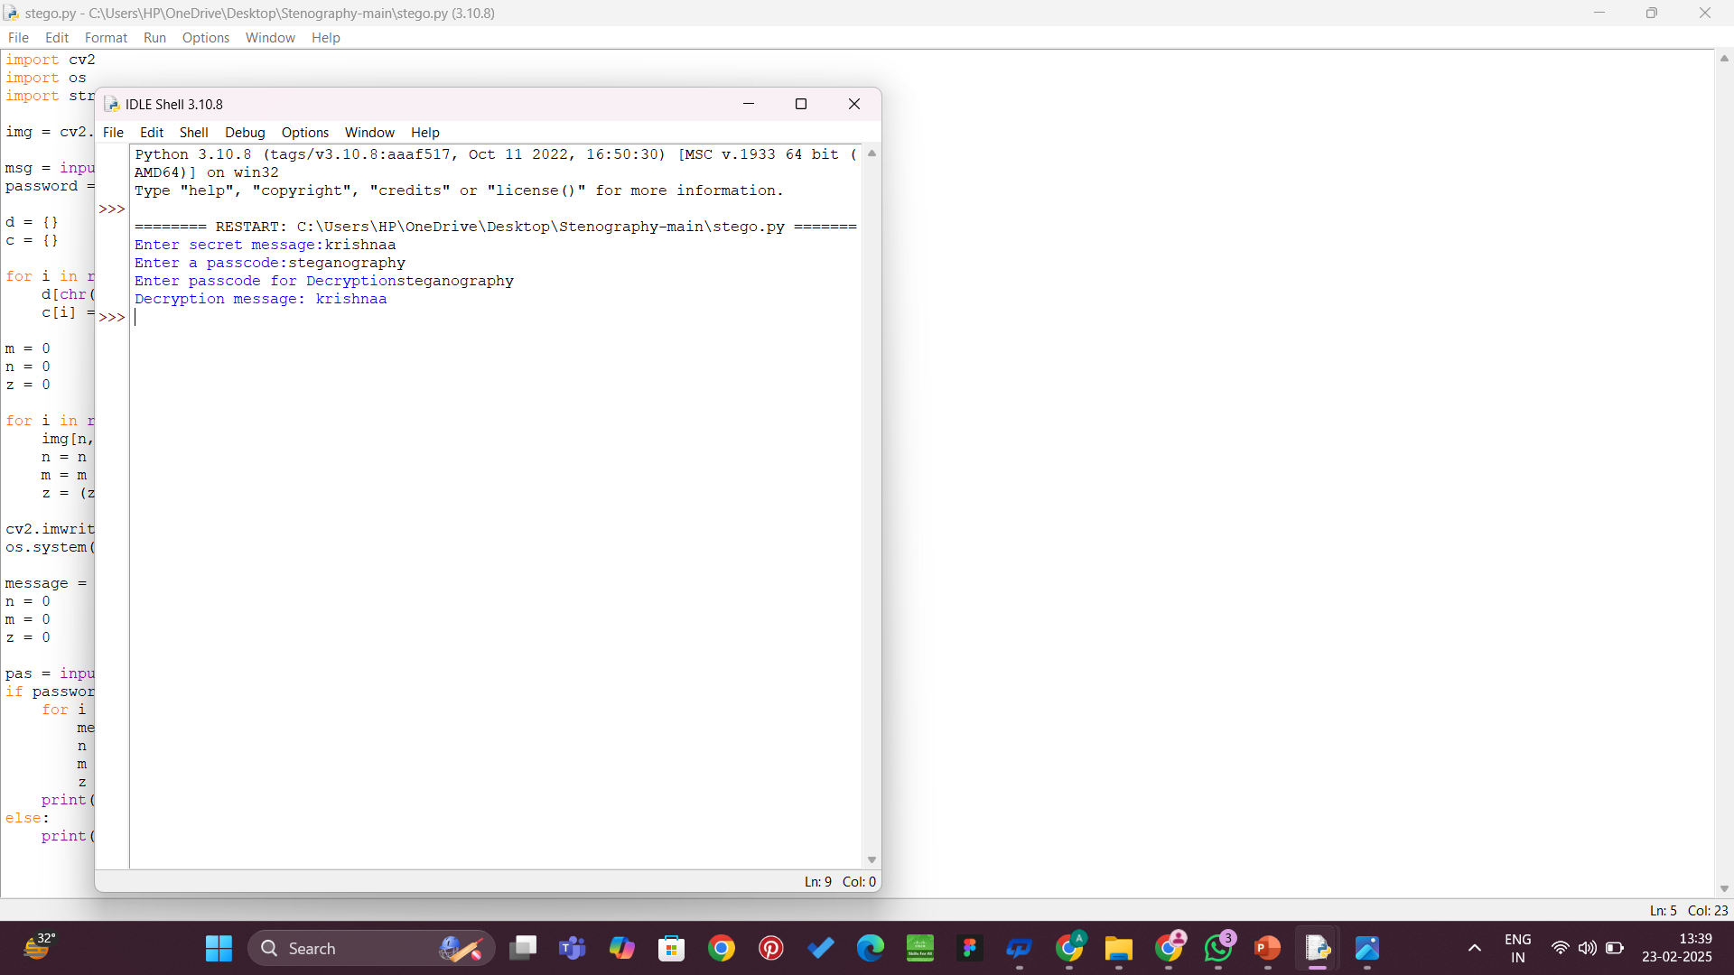
Results
Encryption output
Decryption output

Slide 8
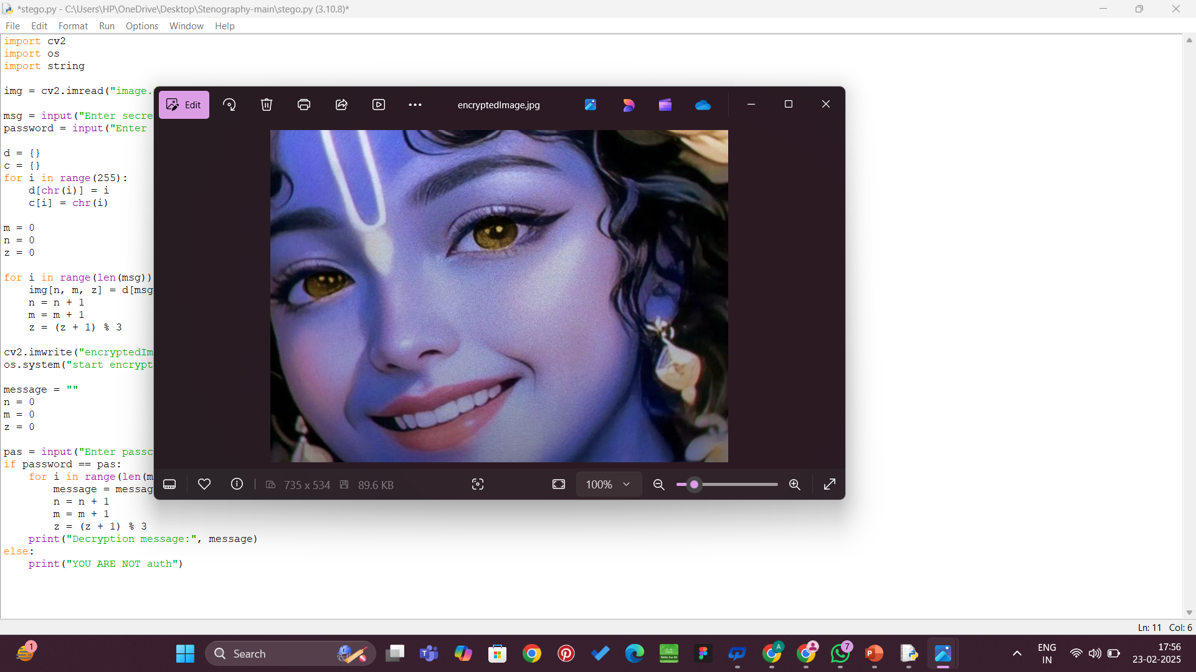
Encrypted image:

Slide 9
Conclusion
This project successfully demonstrates how steganography can enhance secure data transmission by hiding messages inside images. Unlike traditional encryption, which signals the presence of sensitive information, steganography provides an additional layer of security by making the message invisible.

Slide 10
GitHub Link
https://github.com/hariakshayavarma/Secure-data-hiding-in-image-using-steganography.git

Slide 11
Future scope
Implementing deep learning for automated steganalysis (detection and prevention).
Enhancing security by adding encryption before embedding data.
Developing a mobile application for easy steganography use.
Exploring video and audio steganography for broader applications.

Slide 12
THANK YOU

